Slide 1
Foodies Project Team
Team Members
Art Miller (Project Manager)
Bret Miller
Charles Chiang
Connor Lamalfa
Deepti Deshpande
Ryan Jacobsen
Trenn Brown

Slide 2



Holiday Food Drive Competition

Slide 3
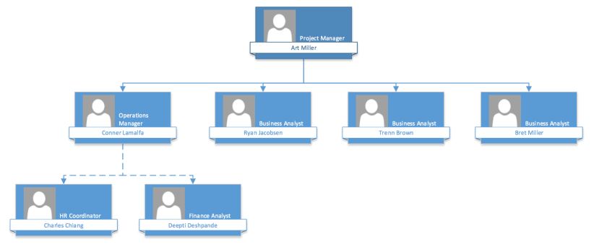
Roles and Org Chart

Slide 4
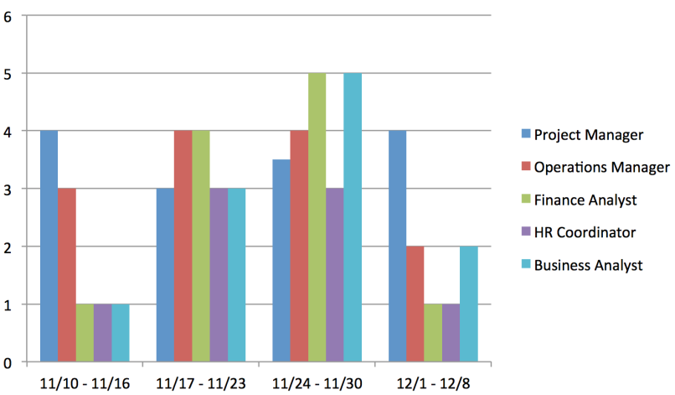
Resource Calendar

Slide 5
Oracle Project Process Flow
Foodies food drive project decided upon
Research Oracle volunteer program
Contacted Utah Food Bank for info
Worked with office manager to set up food drive logistics
Food drive approval granted
Applied to start food drive at Oracle
Purchased containers and distributed in office
Sent email marketing food drive campaign
Food collection began (11/18)
Closed out campaign in Oracle volunteer website
Donations taken to Utah Food Bank
Food collection ended (12/5)

Slide 6
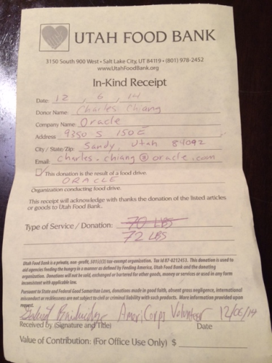
Oracle Food Drive Summary
The Oracle Food Drive, which completed on 12/5, was able to donate a total of 72 pounds of food. The total, with of 40 employees:
72lbs / 40 EMPLOYEES =
1.8 lbs / EMPLOYEE

Slide 7
EMC Project Process Flow
Foodies food drive project decided upon
Contacted EMC project planning committee
Decided ‘foodies’ team responsible for physical food drive
Created office marketing materials for food drive
Decided timeframe for food drive (11/24 – 12/31)
Contacted Utah Food Bank for info
Picked up three 55 gallon collection drums from food bank
Delivered bins to 2 EMC office locations
Food collection began (11/24)
Delivery of physical items to Utah Food Bank (12/31)
On-going collection process
Assisted in “Santa Saturday” collection event (12/6)

Slide 8
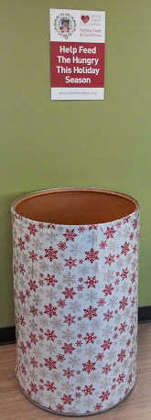
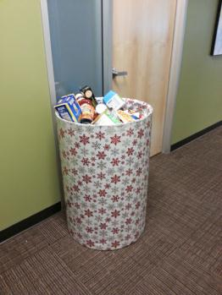
EMC Food Drive Summary (so far)
EMC’s food drive is still active and will remain so until December 31, 2014
2 of the 55 gallon collection drums are been filled up at this time
1drum = 55 gallons = 150 -200lbs of food items
~300-400lbs food items currently

Slide 9
Food Drive Competition Status
Target Goal: 500lbs between Oracle and EMC
Current Status (with three weeks remaining):
Oracle + EMC = ~450lbs

Slide 10
Budget Plan
Total Budget = $245 (BAC)
Activity | PV | EV | AC | SPI | CPI
Bins and Supplies | 50 | 50 | 60 | 1 | 0.8
Promotions | 30 | 30 | 40 | 1 | 0.7
Decorations | 150 | 150 | 200 | 1 | 0.7
Fuel | 15 | 15 | 10 | 1 | 1.5
Notes:
We allocated the budget of 245 for this project for different activities like getting the bins, decorations and fuel
As you can see the metrics, we did good on schedule but went over budget for most of the activities

Slide 11
Cumulative Cost Curve

Slide 12
Budget Plan
BAC = 245
EAC = AC/ Percent Complete = 413
ETC = EAC – AC = 103
VAC = BAC – EAC = -168

Slide 13
Questions?

Slide 14
Thank You!!

